Slide 1
Module – 1 (SDLC)
- Ayush m . Dhabaliya

Slide 2
WHAT IS SOFTWARE ?
The software is basically a set of instructions or commands that tell to computer what to do. Without software system cannot be run. Software is basic necessity to run computer. In other words, functionality depends on software.
WHAT IS SOFTWARE ENGINEERING ?
Software engineering is an engineering discipline that is concerned with all the aspects of software production. This is a simple definition of software engineering, To develop any software there some limitations like what is the space of software, what is software requirements, on what basis the software was developed, how software works….

Slide 3
Behind any software there are group of people or we can say team works.
There are mainly five types of software.
System software
Application software
Programming software
Driver software
Middle software,

Slide 4
System software : - System software is required to run system. For example OS, Linux, Microsoft, IOS, etc…
Application software : - Application software consists of programs designed to make users more productive or assist them with personal tasks.
Mainly there are 3 types of software.
Mobile Application : - mobile applications like Instagram, Whatsapp, Gpay, etc..
Desktop Applications : - desktop application like anydesk, picasa, gta, vice city etc…..
Web Application : - Web application like Firefox, Microsoft office, opera etc..

Slide 5
Programming Software : - Programming software means to require software that runs behind program. For example compiler, interpreter.this software mostly used in coding application.
Driver Software : - Driver software is main handle of software, means we can say that driver is main part of software. It is one type of software only but without driver software not single software runs no matter software is large or small. For example music driver for music software, Bluetooth, character driver etc..
Middleware : - Middleware is a type of software used to connect to software like we can say database is best example for it. Here middleware stores the information of connected software like data in database.

Slide 6
WHAT IS SDLC ?
The full form of SDLC is Software Development Cycle. SDLC means totally overview of software, means what is the design of the software, how it works, fonts, color, everything.
Lets understand phases of SDLC
Planning
Analysis
Design
Implementation
Testing
Maintainance and update

Slide 7
Planning : - Software planning means what you want to add on software and how it works in future?, what is inside in software?, there are many things. Also authority of admin and user, functions logo etc…
Analysis : - Software analysis means after you and your client discussion , you have to analyse of your software comparatively with market, what is the process and all the other things. After that you have to analyse what is requirement of your software and your team.
Design : - Designing of software is must required in siftwar4e, means how it looks ?, design, colour, logo, fonts, notification shades etc…
Implementation : - After designing we are ready to implement work on it and start to complete work on software, every small and large business on it.

Slide 8
Testing : - After completing work on software, there is team for testing your software. Testing is necessary if any bug, error or issue in is there in software implementation, so before going live it will be solved and your software runs smoothly without error and this will be handled by the testing team
Maintainance and Update : - After going live it is necessary to maintain your software and upgradation is also required in software for the upcoming features use in your software in future, and also required for bugs and error for this maintainance and upgradation is required.

Slide 9
WHAT IS DFD ?
DFD means data flow diagram, this methodology is used to understand theoretically process of software. DFD shows complete process of software from top to bottom, we can say that it is like user authority, data flow, data store, admin authority and many more. DFD is generally used to understand software easily, means after understanding the engineers knows what is to be done next. This is the process of DFD.
Types of DFD
Zero level or Context level DFD
One level or Two level DFD

Slide 10
Zero level DFD : - Zero level DFD shows the only data flow of user and admin, no other process is in zero level DFD. In other words we can say that user login and login confirmation same as admin, this will count in zero level DFD.
One level DFD : - This DFD shows all over process of software from starting to end everything, like user login, confirmation same as admin side, data connectivity everything is in one level DFD.

Slide 11
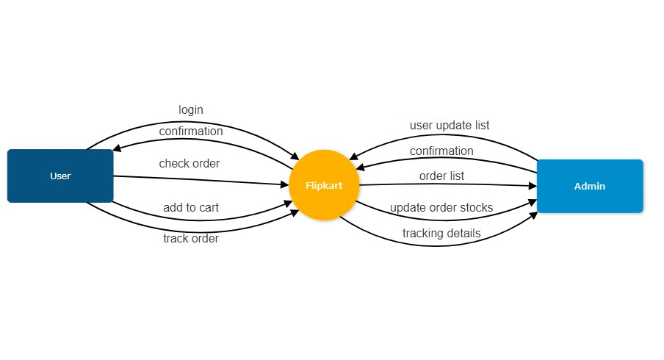
Zero level DFD

Slide 12
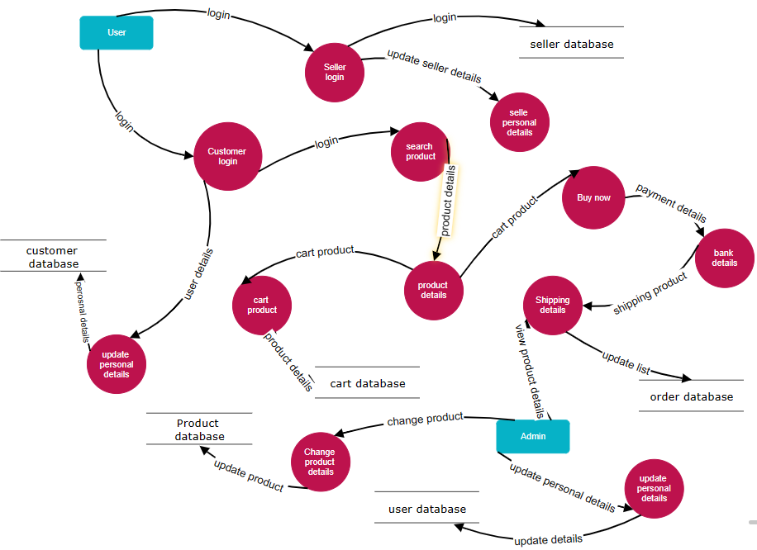
One level DFD

Slide 13
FLOW CHAT
Flow chart means process of programming. Flow chart will help to understand program in easy way.
Flow chart will show all over process of program. After flow chart came in market it is very is to handle problems in program .
Flow chart shows step by step details of program, any mistake or bug in our program it will solve my flow chart means we can get to know what is problem and where it is. Flow chart in other words we can say photo type view of program.

Slide 14
Thus, flow chart is very helpful in our day to day program for better understanding, and also it will help if we want to show to others, means you can prepare flow chart of program and present to your client or boss to understand and it is very helpful by this method.
There are total 3 types of floe chart :-
Liner flow chart
Branching flow chart
Looping flow chart

Slide 15
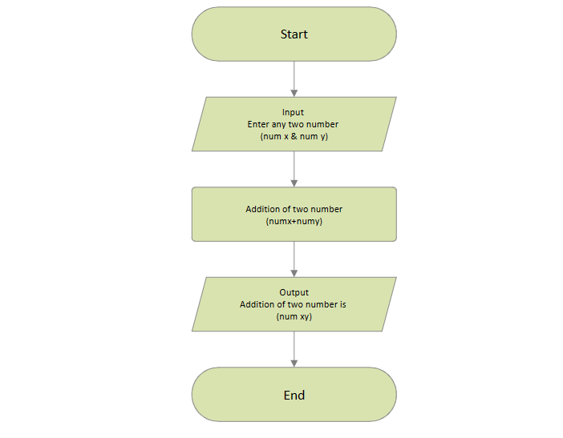

Slide 16
INTERACTION MODULE
Interaction module or we can say that use case. Use case means how user can interact with our system.
And also show the interaction with product, it is also helpful to describe step by step information by creating case.
Case will show the authority of user side and admin side, and this module is also helpful to show steps of your case to others.

Slide 17
